Slide 1
Transmasculine Bottom Surgery
Transmasculine Bottom Surgery
Transmasculine Bottom Surgery
Overview of Gender-Affirming Genital Reconstruction
By George!

Slide 2
Metoidioplasty Overview
Frees the existing erectile tissue by cutting the tissue that holds it down against the body
Average phallus length: 4–6 cm
The penis might be enhanced by using nearby tissues (labia, etc) to create more girth in “ring” and “centurion” methods, but generally length is dependent on growth from testosterone.
Length can be lost post-operatively

Slide 3
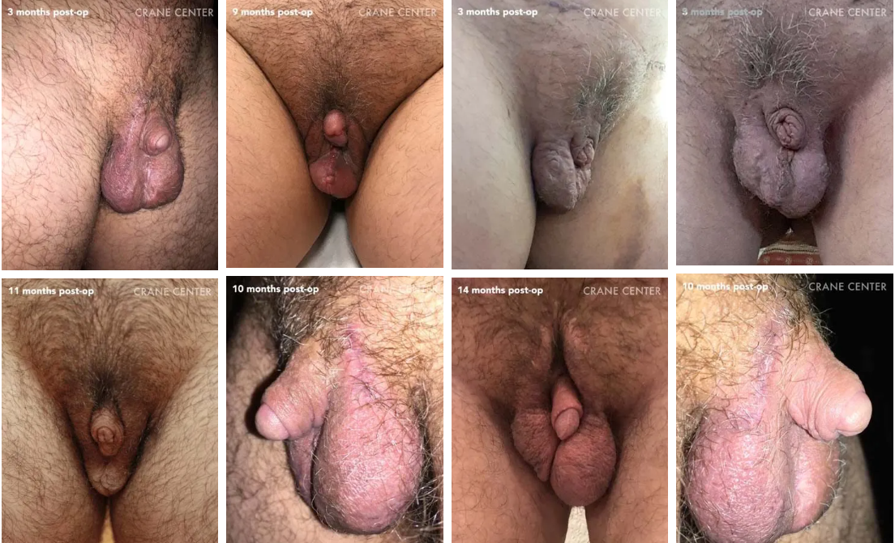
Meta

Slide 4
Radial Forearm Flap (RFF) Phalloplasty
Most commonly performed type of phalloplasty
Utilizes thin, supple forearm skin that is easily tubed and shaped into a phallus
Requires hair removal
Allows for:
  Good aesthetic contour
  Erogenous sensation
  Urethral reconstruction, often in a single stage

Slide 5
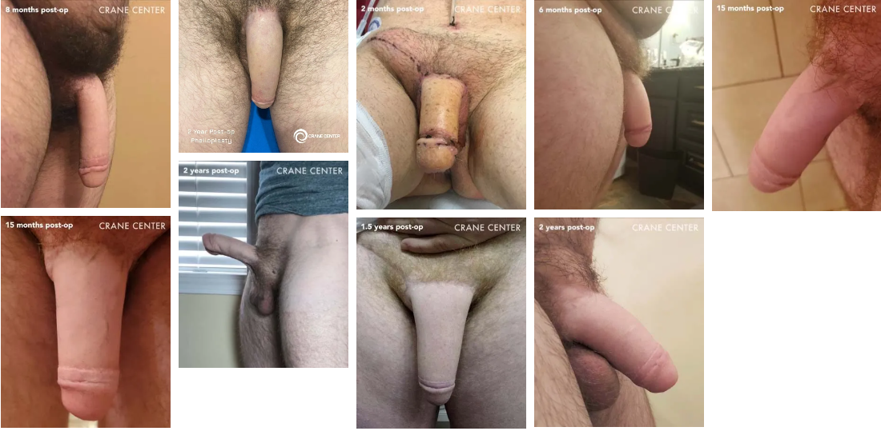
Radial Forearm Flap (RFF) Phalloplasty

Slide 6
Anterolateral Thigh (ALT) Phalloplasty
Uses skin and tissue from the outer thigh to create a phallus
Common alternative to radial forearm flap phalloplasty
Inconspicuous donor site (easily hidden by shorts)
Better suited for individuals with a low BMI
Carries a higher risk of urethral complications and often results in higher girth/bulkiness, requiring potential secondary thinning (debulking) surgeries

Slide 7
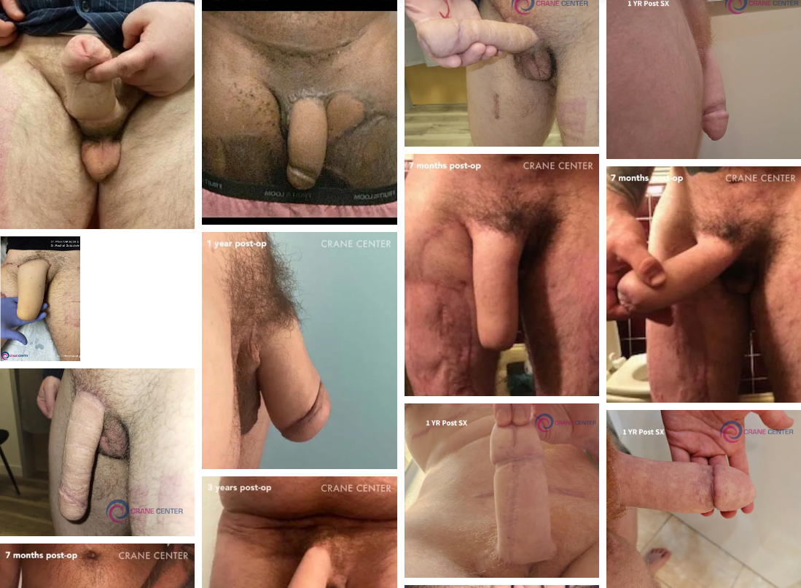
Anterolateral Thigh (ALT) Phalloplasty

Slide 8
Abdominal Phalloplasty
Tissue is taken from the lower abdomen, allowing scars to be discreet
No hair removal before surgery
Abdominal skin often matches well in color and texture, creating a natural-looking result
No skin graft required at the donor site

Slide 9
Musculocutaneous latissimus dorsi – MLD Phalloplasty
Uses skin and tissue from the back to create a phallus
Less common than other procedures
Cons=poor sensation

Slide 10
Associated Procedures
Urethral Lengthening: Extension of the urethra so that you can urinate through the new penis.
Mons Resection/Monsplasty: Lifting and/or reducing of the pubic area so that the new penis is higher on the body and more visible.

Slide 11
Associated Procedures
Scrotoplasty: uses labia majora tissue to form a scrotum in the male anatomical position
Testicular implants are typically placed 6 months after scrotoplasty
Tissue expanders may be used beforehand for patients desiring a larger scrotum

Slide 12
Resources
https://www.metoidioplasty.net/procedures/centurion-metoidioplasty.htm
https://cranects.com/
https://surl.lt/yighqu
http://progresscolab.net/wp-content/uploads/2024/09/PROGRESS-To-Print-Pages-1.pdf

