Slide 1

FtM
Bottom
Surgery
Chase Smith

Slide 2
Bottom Surgery Options
: Metoidioplasty
: Phalloplasty

Slide 3
Metoidioplasty “meta”
Releasing a hormonally enlarged clitoris and covering the phallus with neighboring skin
: average length being 4-6 cm
Optional: urethroplasty – lengthening the urethra to the tip of the phallus
vaginectomy – removal of the vagina
scrotoplasty – formation of a scrotum using native labial majora tissue
testicular implants – solid silicone implants (6 months after scrotoplasty)

Slide 4
Phalloplasty
Construction or reconstruction of a penis or the artificial modification of the penis
Anterolateral Thigh Flap (ALT)
: dissection of arteries, veins, and nerves
: skin, fat, fascia flap that has blood supplied by the descending branch of the lateral femoral circumflex vessels and innervation provided by the lateral femoral cutaneous nerve
: ALT may require additional procedures; 1 to 4 stages
: Length/girth size can be chosen more so than RFF
Delayed ALT Flap
:additional step in the ALT Phalloplasty
: severing the blood supply to the tissue of the upper thigh that will become the phallus while leaving the tissue in its anatomical location
: allows the tissue some time to adapt the new blood supply before being moved to the new location, usually 4-6 months
Optional:
urethroplasty – lengthening the urethra to the tip of the phallus
vaginectomy – removal of the vagina
scrotoplasty – formation of a scrotum using native labial majora tissue
glansplasty – creation of penis crown resulting in circumcised-looking phallus
testicular implants – solid silicone implants (9-12 months after scrotoplasty)
penile implant – semi-rigid or inflatable implant that allows for penetrative intercourse (9-12 months after phalloplasty)

Slide 5
Phalloplasty
Construction or reconstruction of a penis or the artificial modification of the penis
Radial Forearm Flap (RFF)
: most common type
: 1 to 2 stages
: 8 to 12 week recovery
: dissection of arteries, veins, and nerves
: donor site is thin and supple which allows the flap to be easily tubed and shaped into phallus
Stage 1: phalloplasty, urethroplasty, vaginectomy, scrotoplasty, glansplasty
Stage 2: testicular implants and penile implant
Optional:
urethroplasty – lengthening the urethra to the tip of the phallus
vaginectomy – removal of the vagina
scrotoplasty – formation of a scrotum using native labial majora tissue
glansplasty – creation of penis crown resulting in circumcised-looking phallus
testicular implants – solid silicone implants (9-12 months after scrotoplasty)
penile implant – semi-rigid or inflatable implant that allows for penetrative intercourse (9-12 months after phalloplasty)

Slide 6
RFF Phalloplasty
Surgery: January 24, 2024
End of Recovery: April 24, 2024
Donor Site for Phallus: Left Forearm
Donor Site for Forearm: Left Thigh
Stage 1 included
: phalloplasty – Clit is buried in phallus for sensation!
: urethroplasty – yes, I can stand to pee!!
bag (jan. 24-feb. 12)
flip flow (feb. 12-feb. 19)
voiding trial (feb. 17-19)
: scrotoplasty
: vaginectomy
: glansplasty
Stage 2 will include
: testicular implants *penile implant is not ideal for ME*
Length: 5 inches (wanted 6 to 6.5 inches)
Girth: 5.5 inches
Notes:
1. What influenced your decision to have surgery? It was a decision that fit my transition, but its not for everyone
2. How does your penis look/work in comparison to a cis male's penis? Look is not exactly like a cis-males and does not operate the same
3. Are you happy with the results? I am very very happy with my results

Slide 7
RFF Phalloplasty disclaimers:
*you can pick your size BUT it is not guaranteed and is based on the length of your blood vessels. Short vessels equal less length and longer vessels equal more length.*
*you can NOT get a boner naturally*
*sensation is NOT guaranteed*
*complications CAN happen*
*bowel prep is required*
*penile implant infection rate (20%) and failure rate (100%)*
Notes:
Semi-rigid: always semi hard and connects to pelvic bone, easily breaks
Inflatable: can be flaccid and has a pump as one of the testicals, 100% failure rate within 10 years but can fail sooner than 10 years
Both have infection rate of 20%

Slide 8
Requirements Prior to Surgery:
Three Letters
: Mental Health Therapist (evaluative role)
: Mental Health Therapist (Ph. D. or Psy. D.)
: Hormone Provider
*will provide recommendations*
Hysterectomy
: 6 months prior to phallo or “meta”
*will provide recommendations*
Hair Removal
: 9-12 months for optimal hair removal
: no sessions within 2 weeks of surgery
*will provide recommendations*
Egg Retrieval
: NOT a requirement but more so a recommendation
: can be done before or after hysterectomy

Slide 9
Requirements Prior to Surgery:
My Process
Hysterectomy: Audie Murphy VA December 2022(Dr. Martin)
San Antonio, TX
Egg Retrieval: UT Health April 2023 (Dr. Yauger)
San Antonio, TX
Hair Removal:
Electrolysis Center Laser Hair Removal November 2022-2023 (Ashley and Courtney)
902 Pat Booker Rd
Universal City, TX 78148
*HIGHLY RECOMMEND, I know the staff personally*
Milan Laser Hair Removal – across the US (only laser)

Slide 10
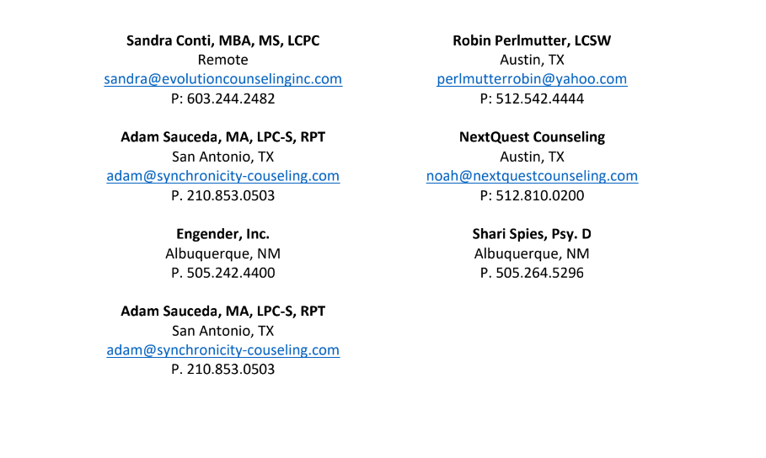
*Mental Health Recommendations*

Slide 11
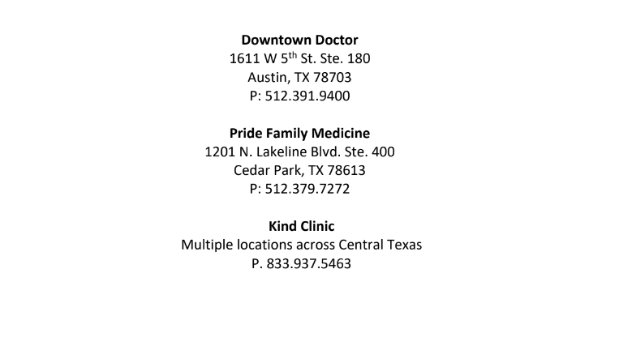
*Hormone Provider Recommendations*

Slide 12
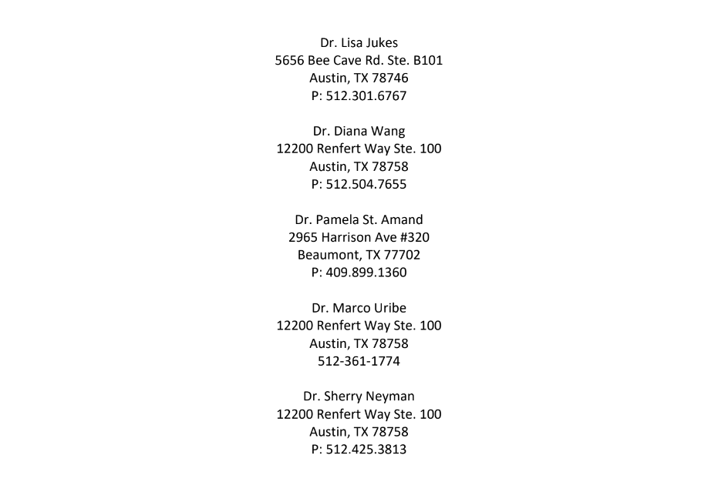
*OBGYN Recommendations for Hysterectomy/Egg Retrieval*

Slide 13
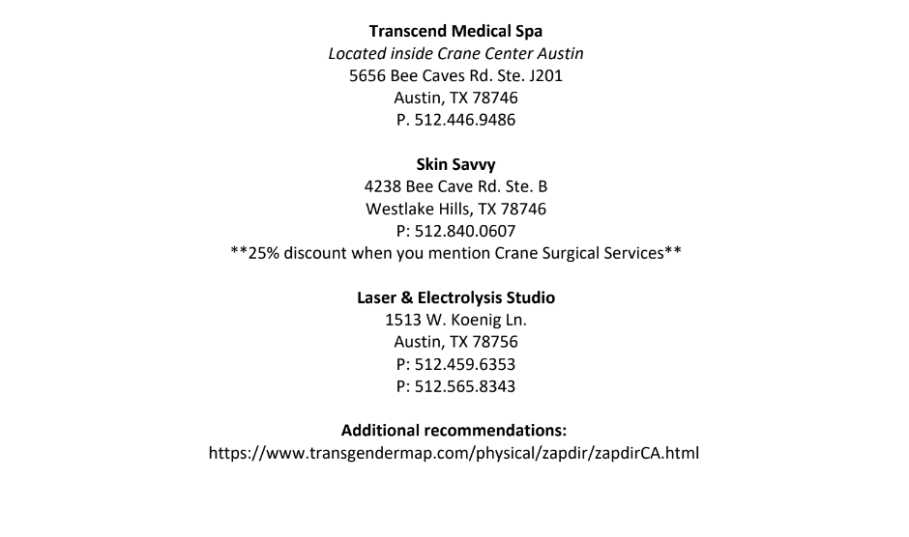
*Laser/Electrolysis Hair Removal Recommendations*

Slide 14
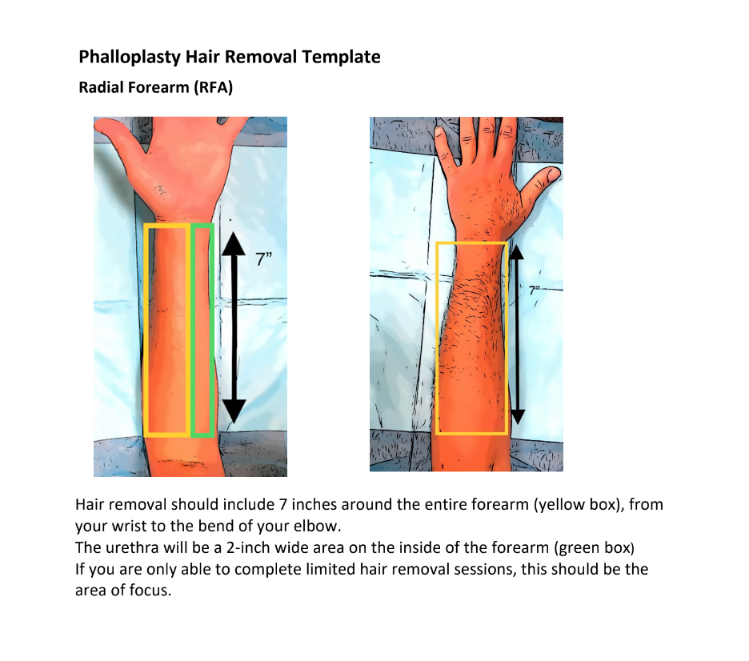
*PLEASE READ*

Slide 15
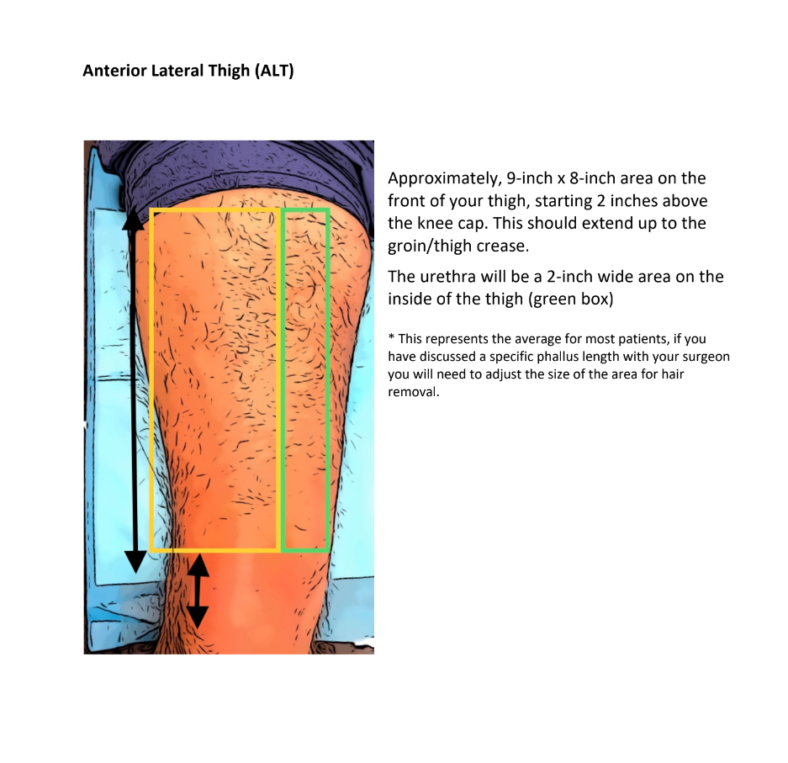
*PLEASE READ*

Slide 16
Penis Sleeve Options:
Look on Amazon search: penis sleeve
*for those that choose not to get a penile implant*

Slide 17
Post-op Needs for Forearm
*reducing swelling
*protection from sun
*softening the scar

Slide 18
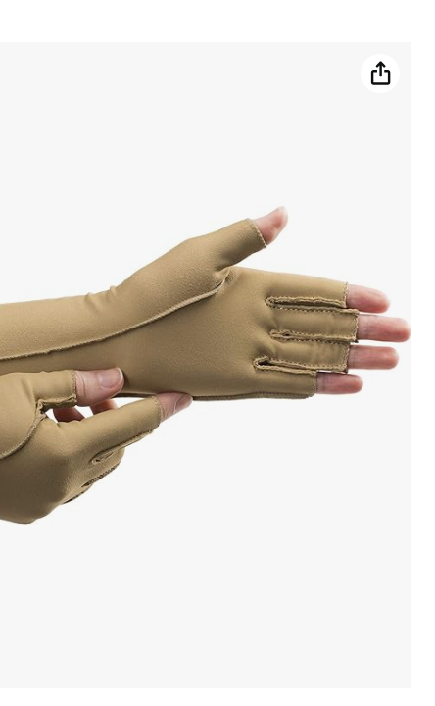
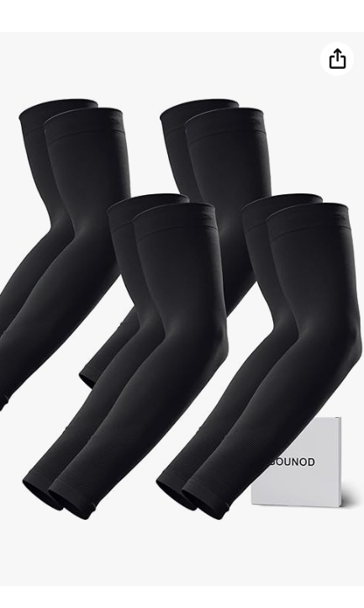
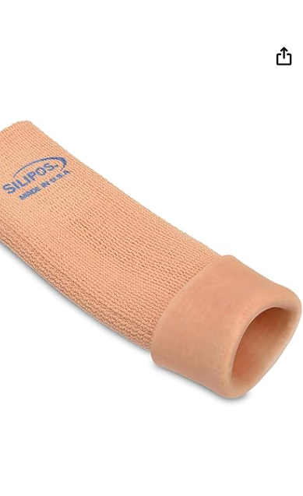

Slide 19
Viewers Discretion is Advised
Rated R Content

Slide 20
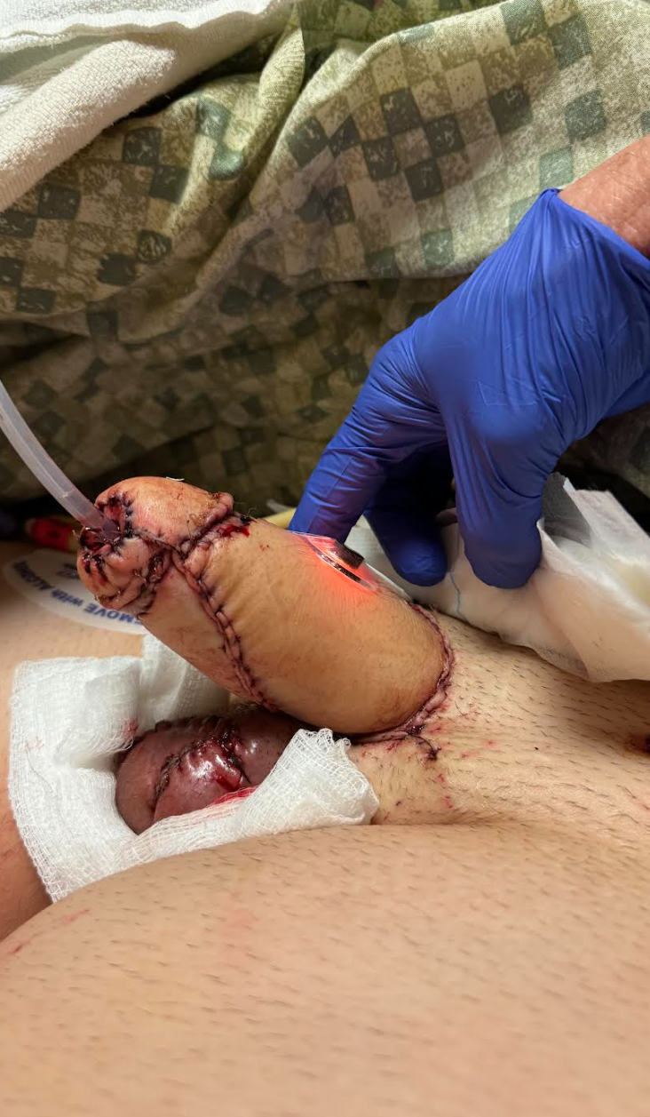
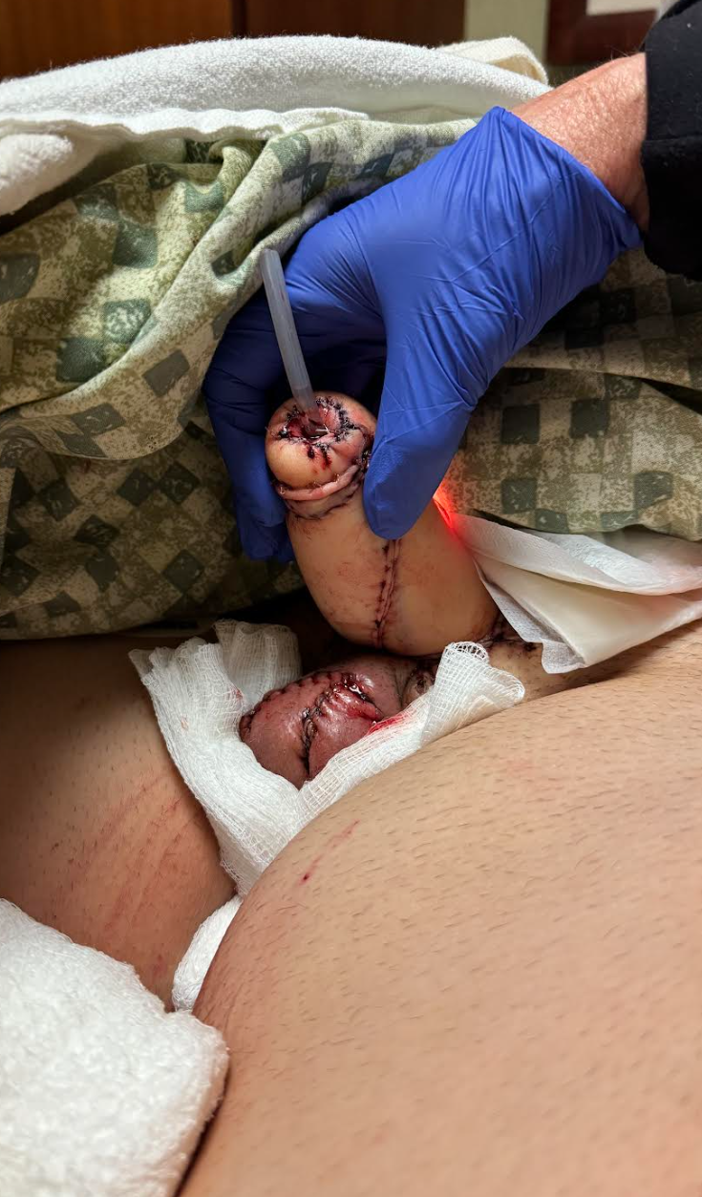
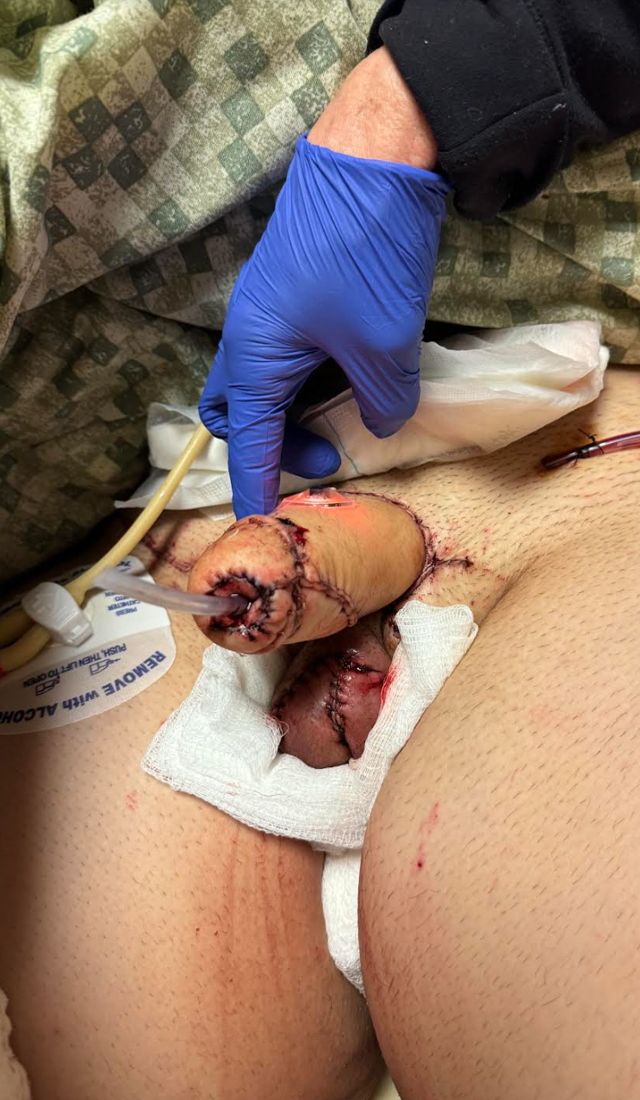

Slide 21
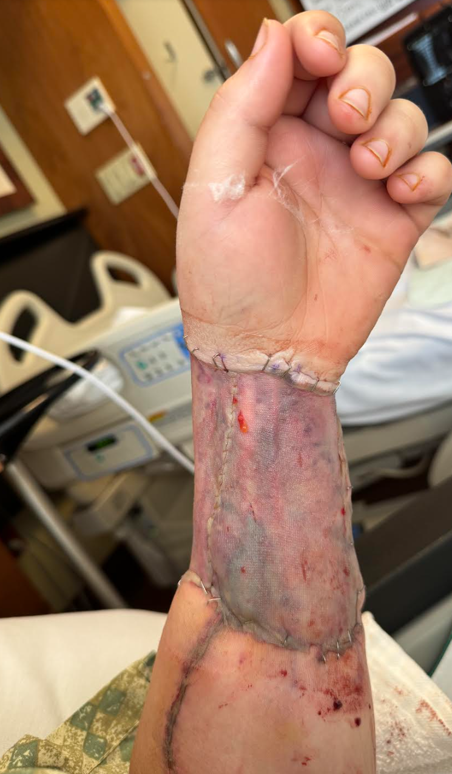
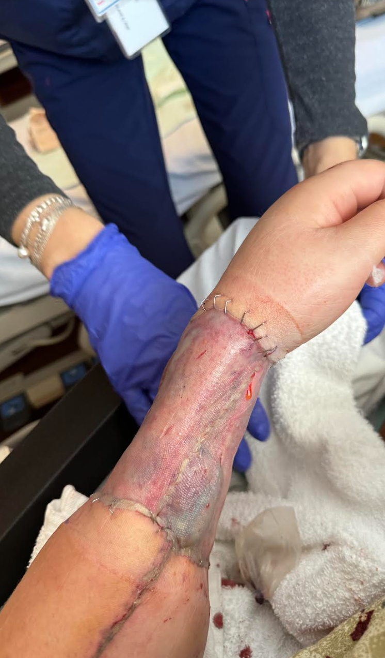
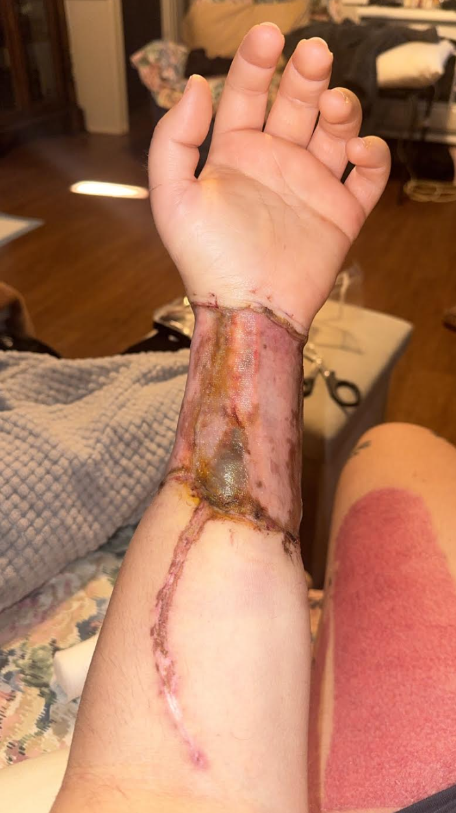

Slide 22
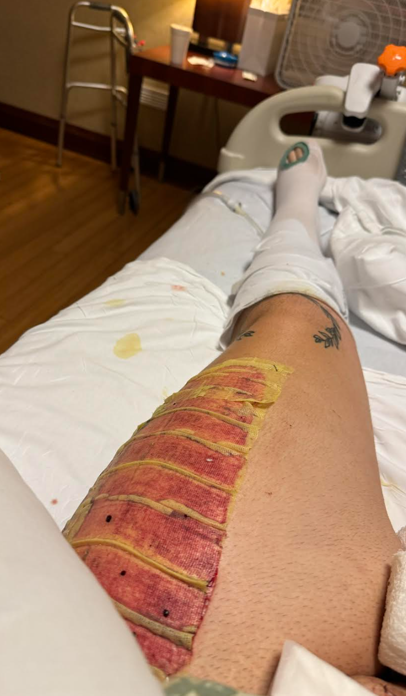
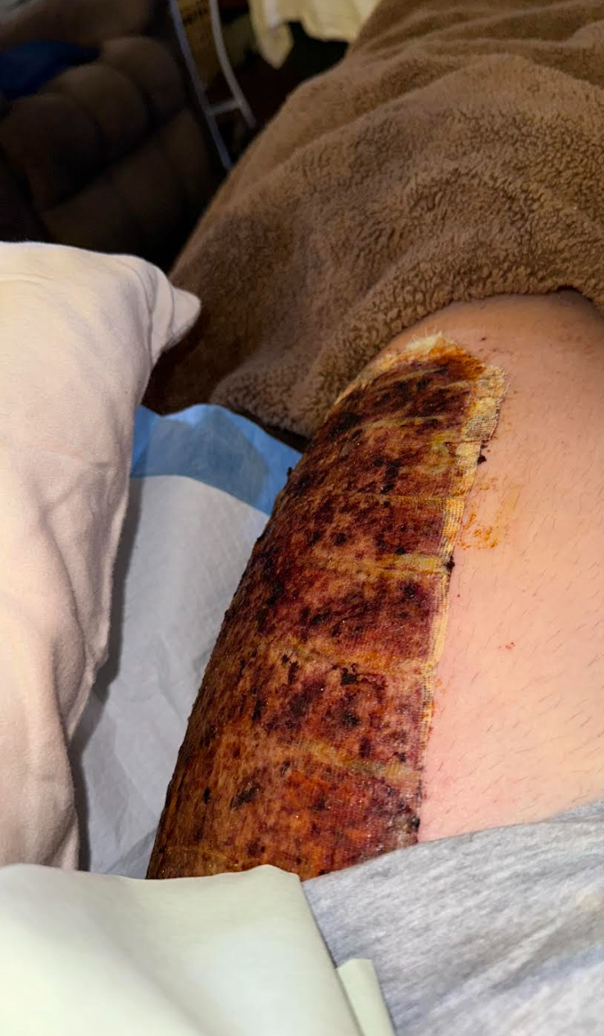
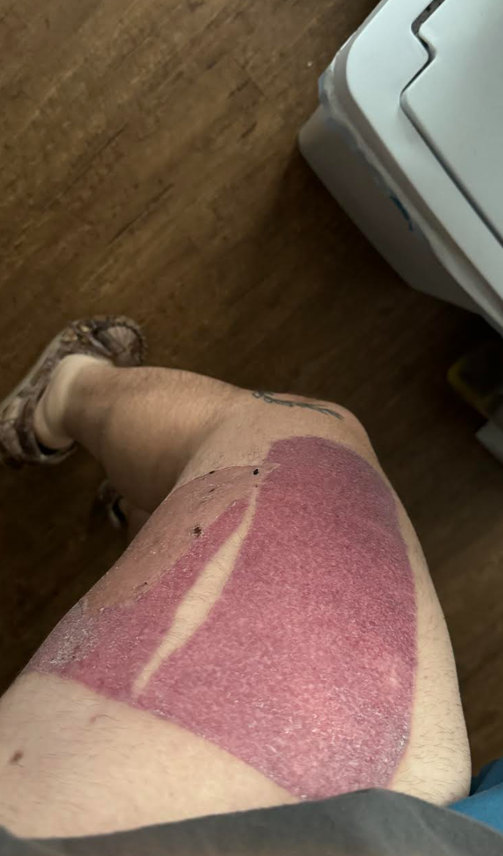

Slide 23
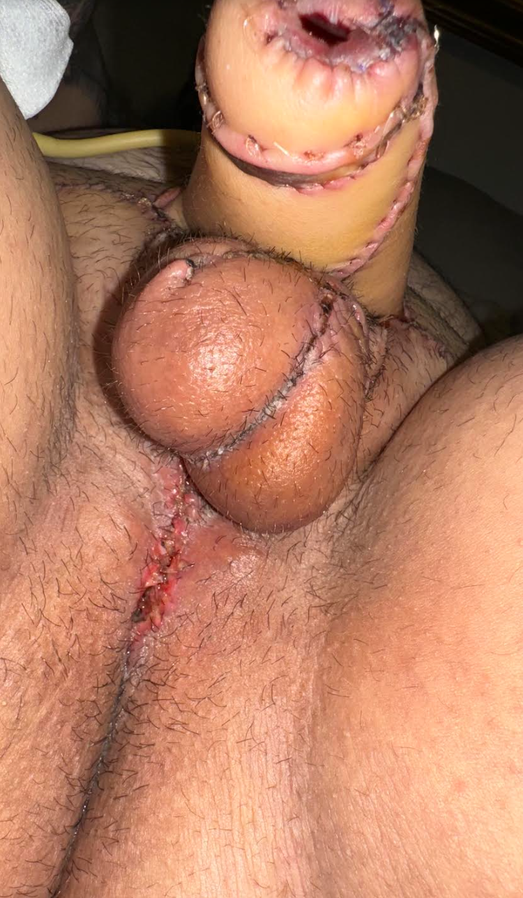
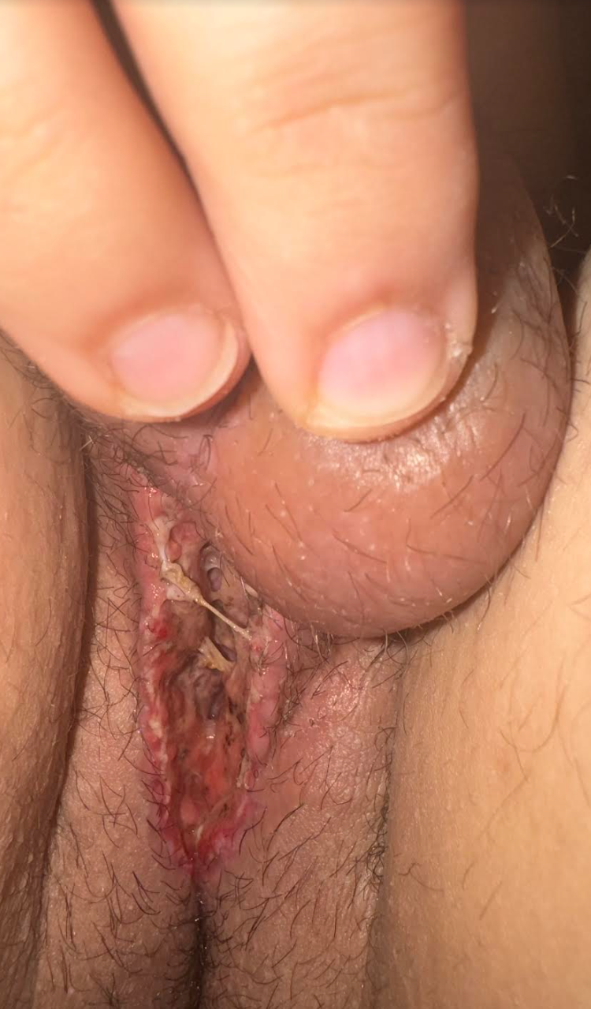
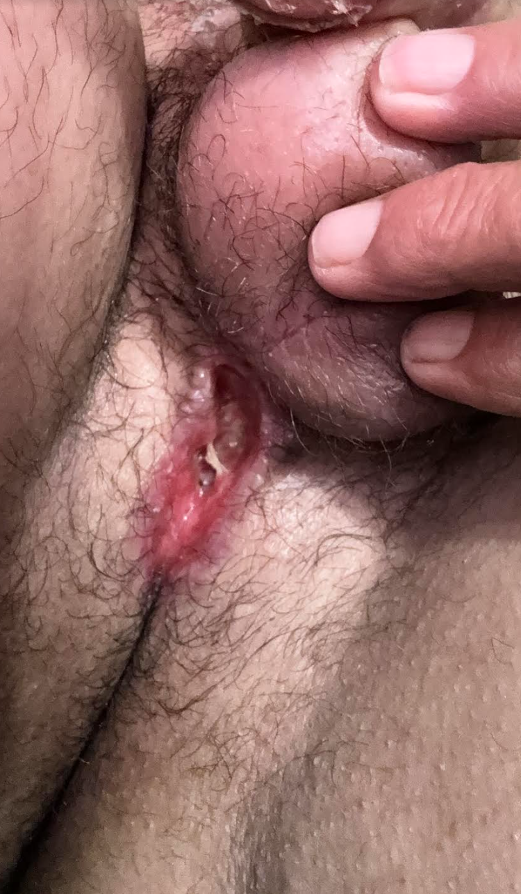

Slide 24
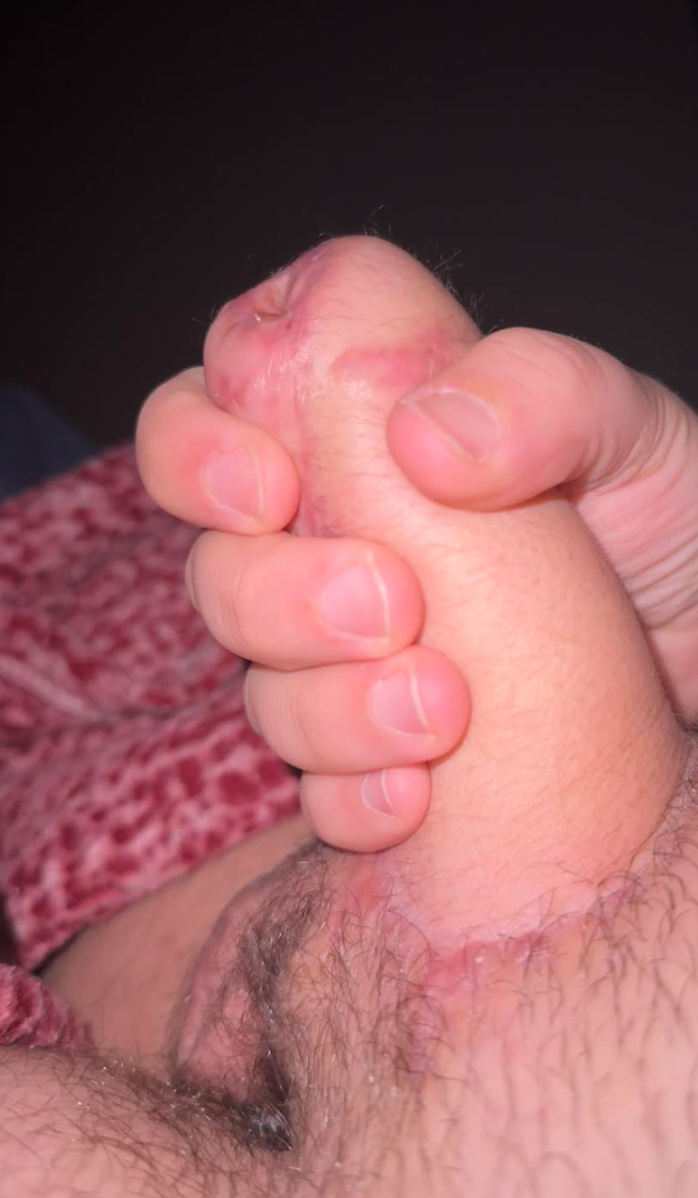
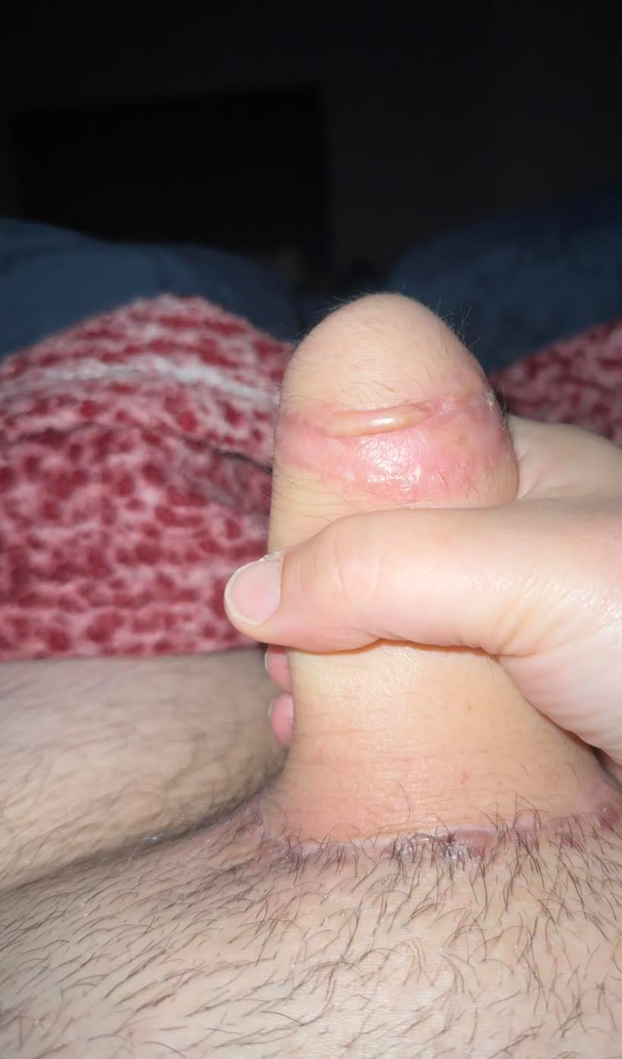
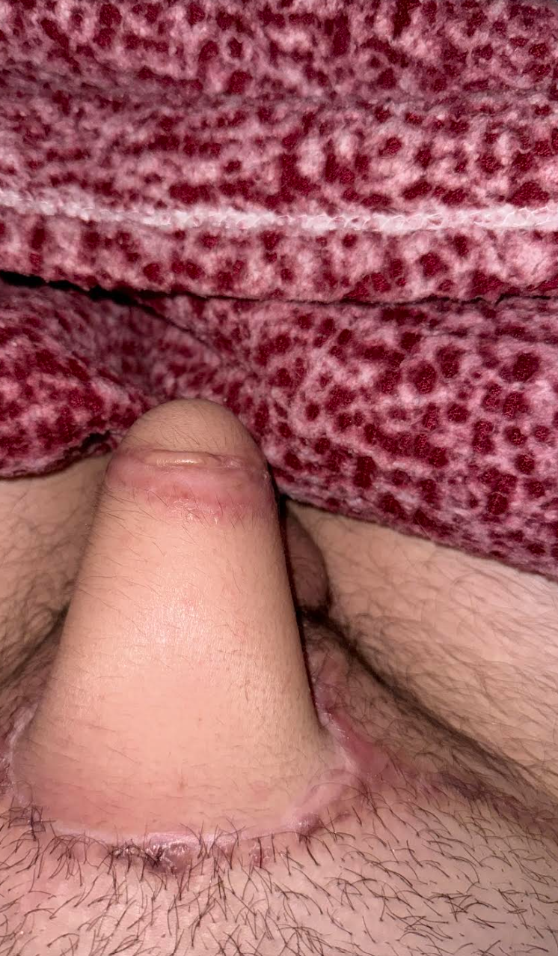

Slide 25
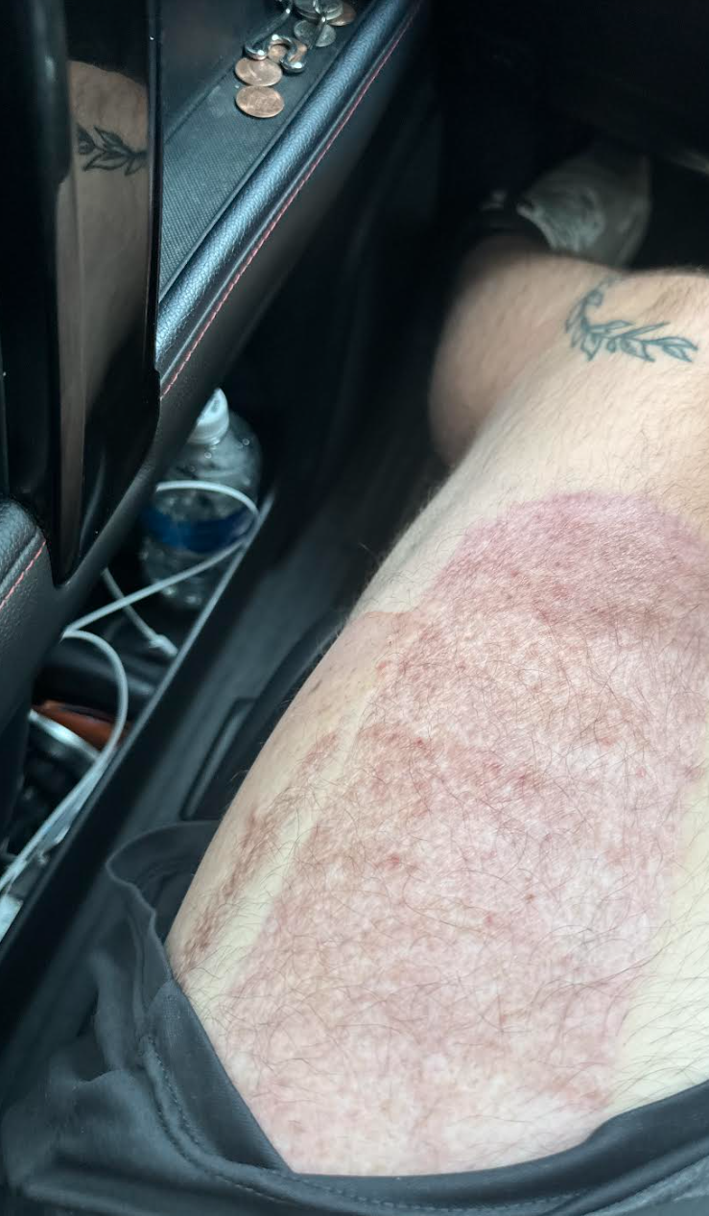
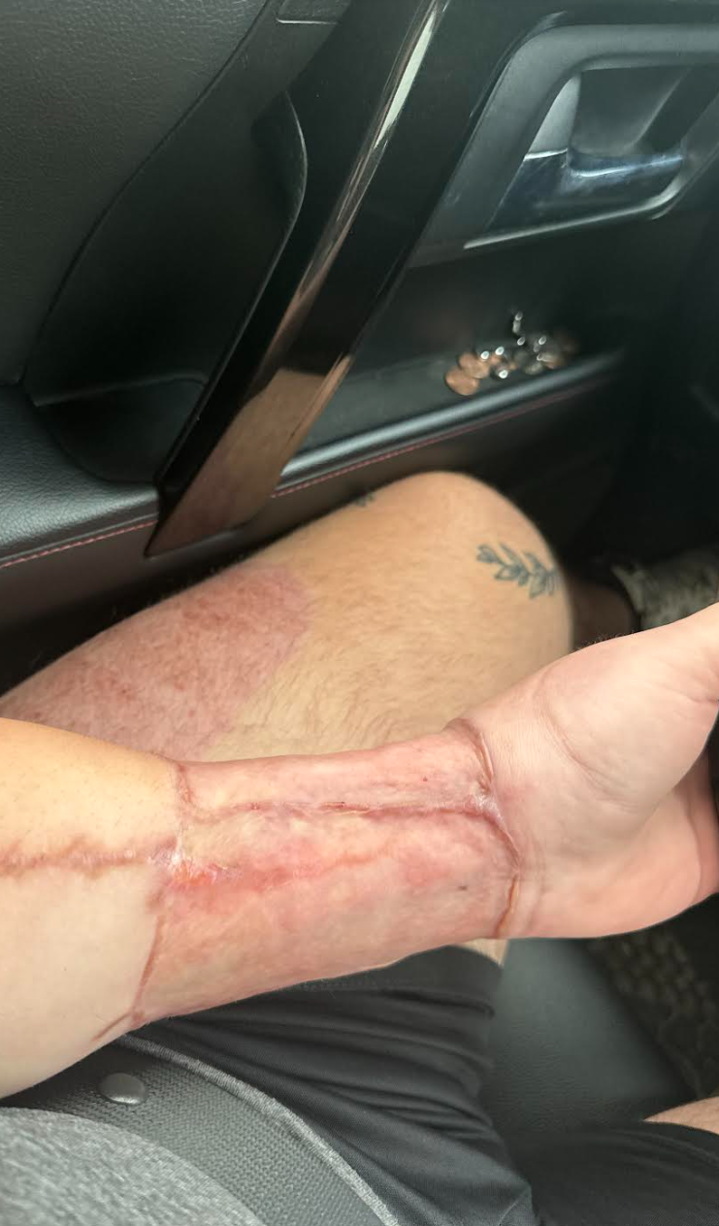
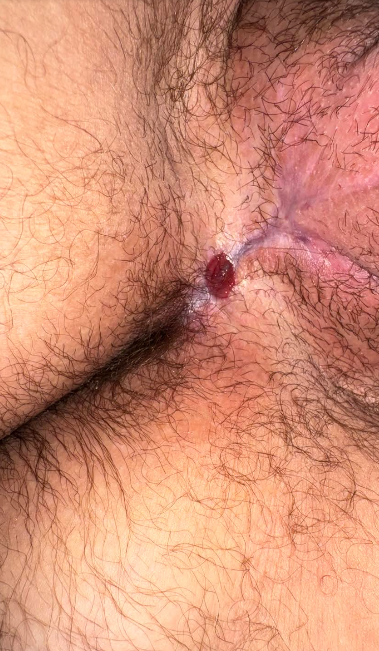

Slide 26
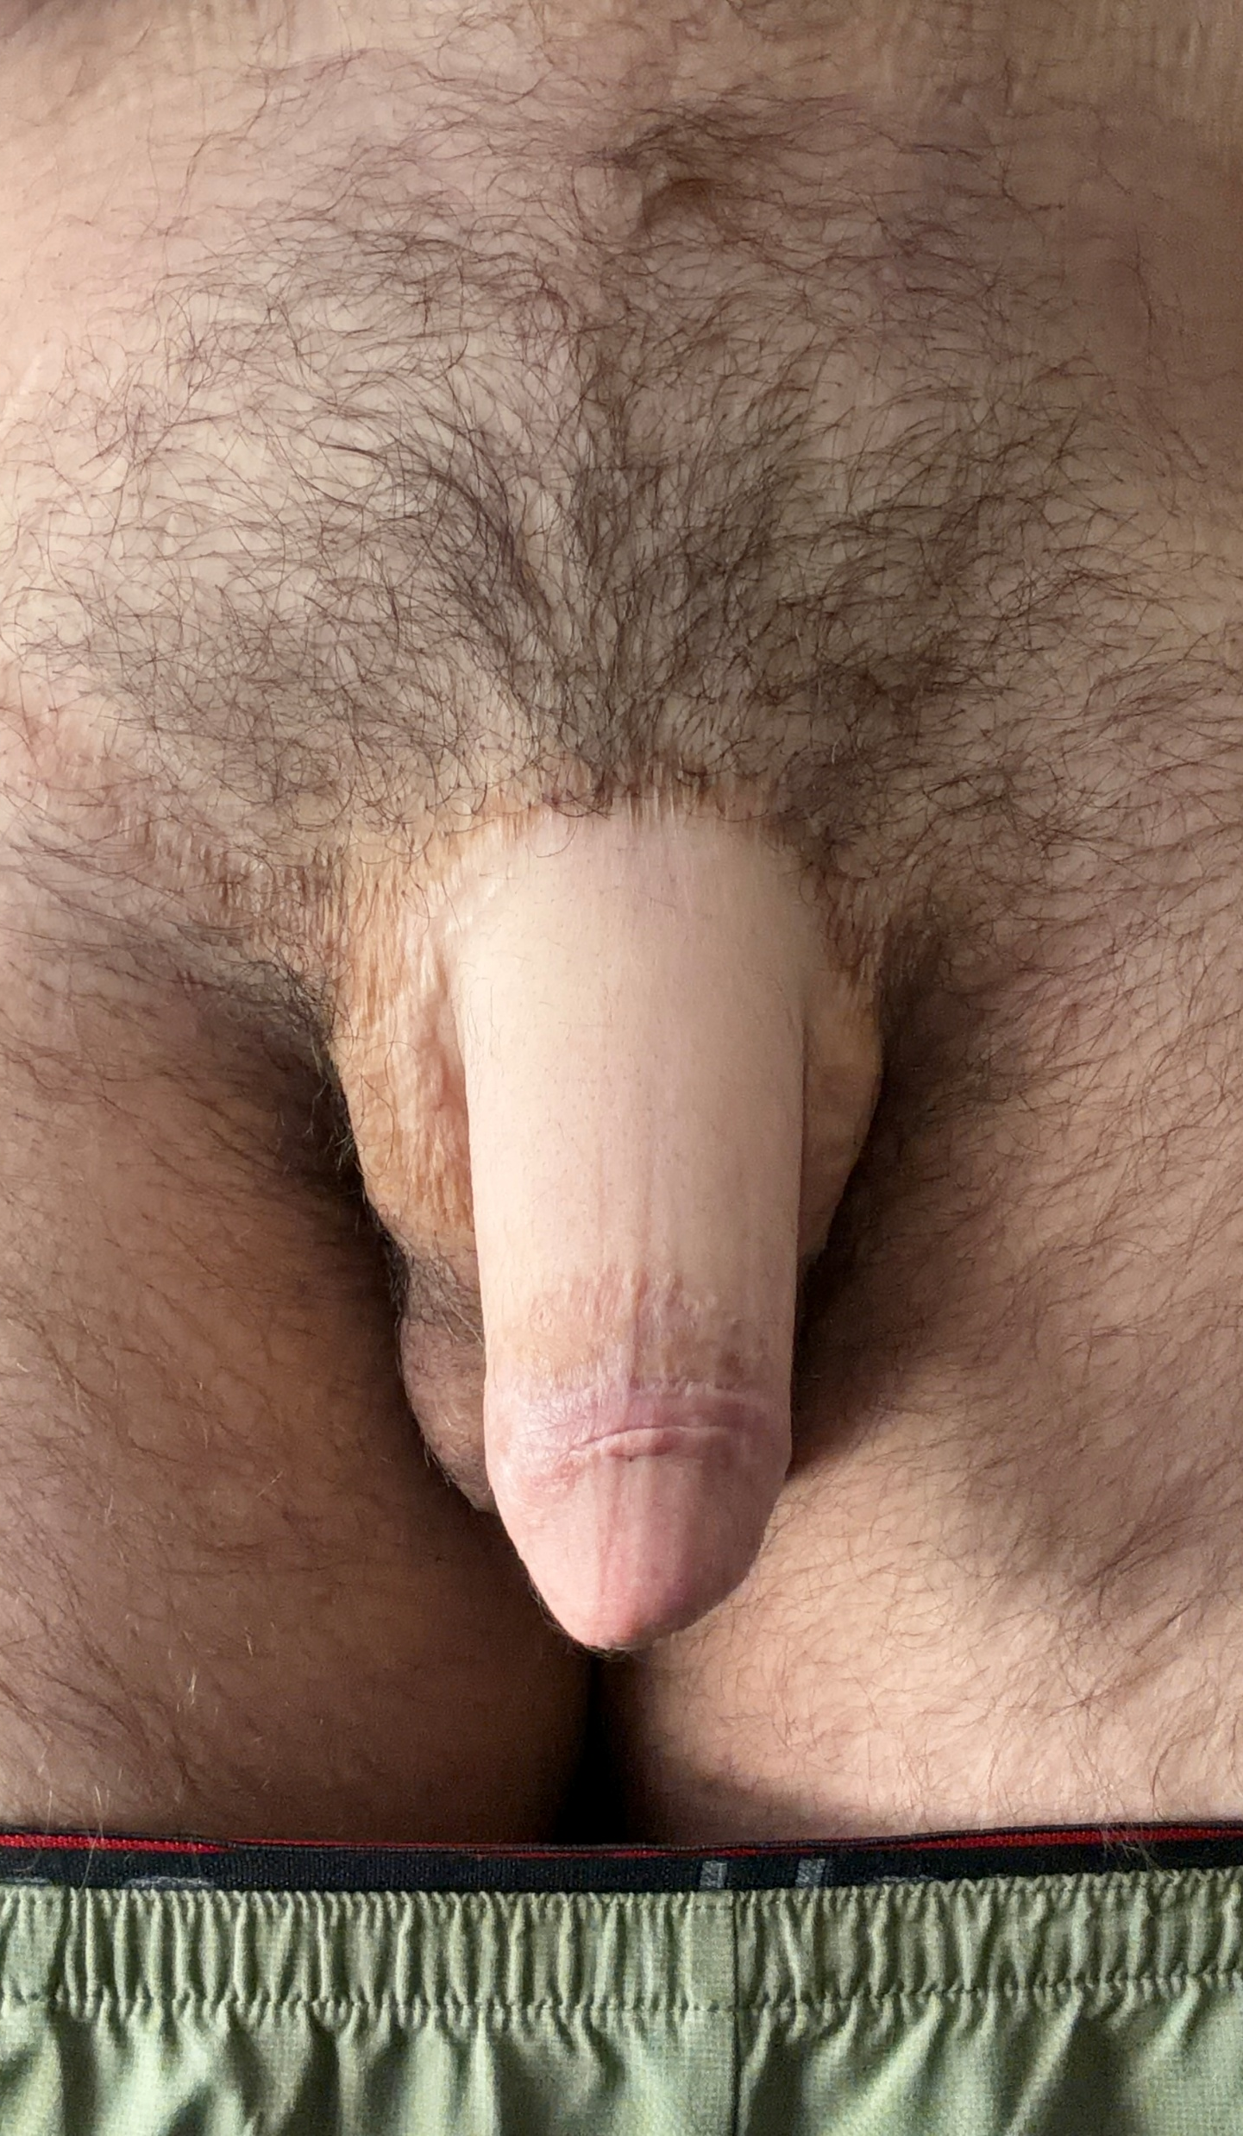
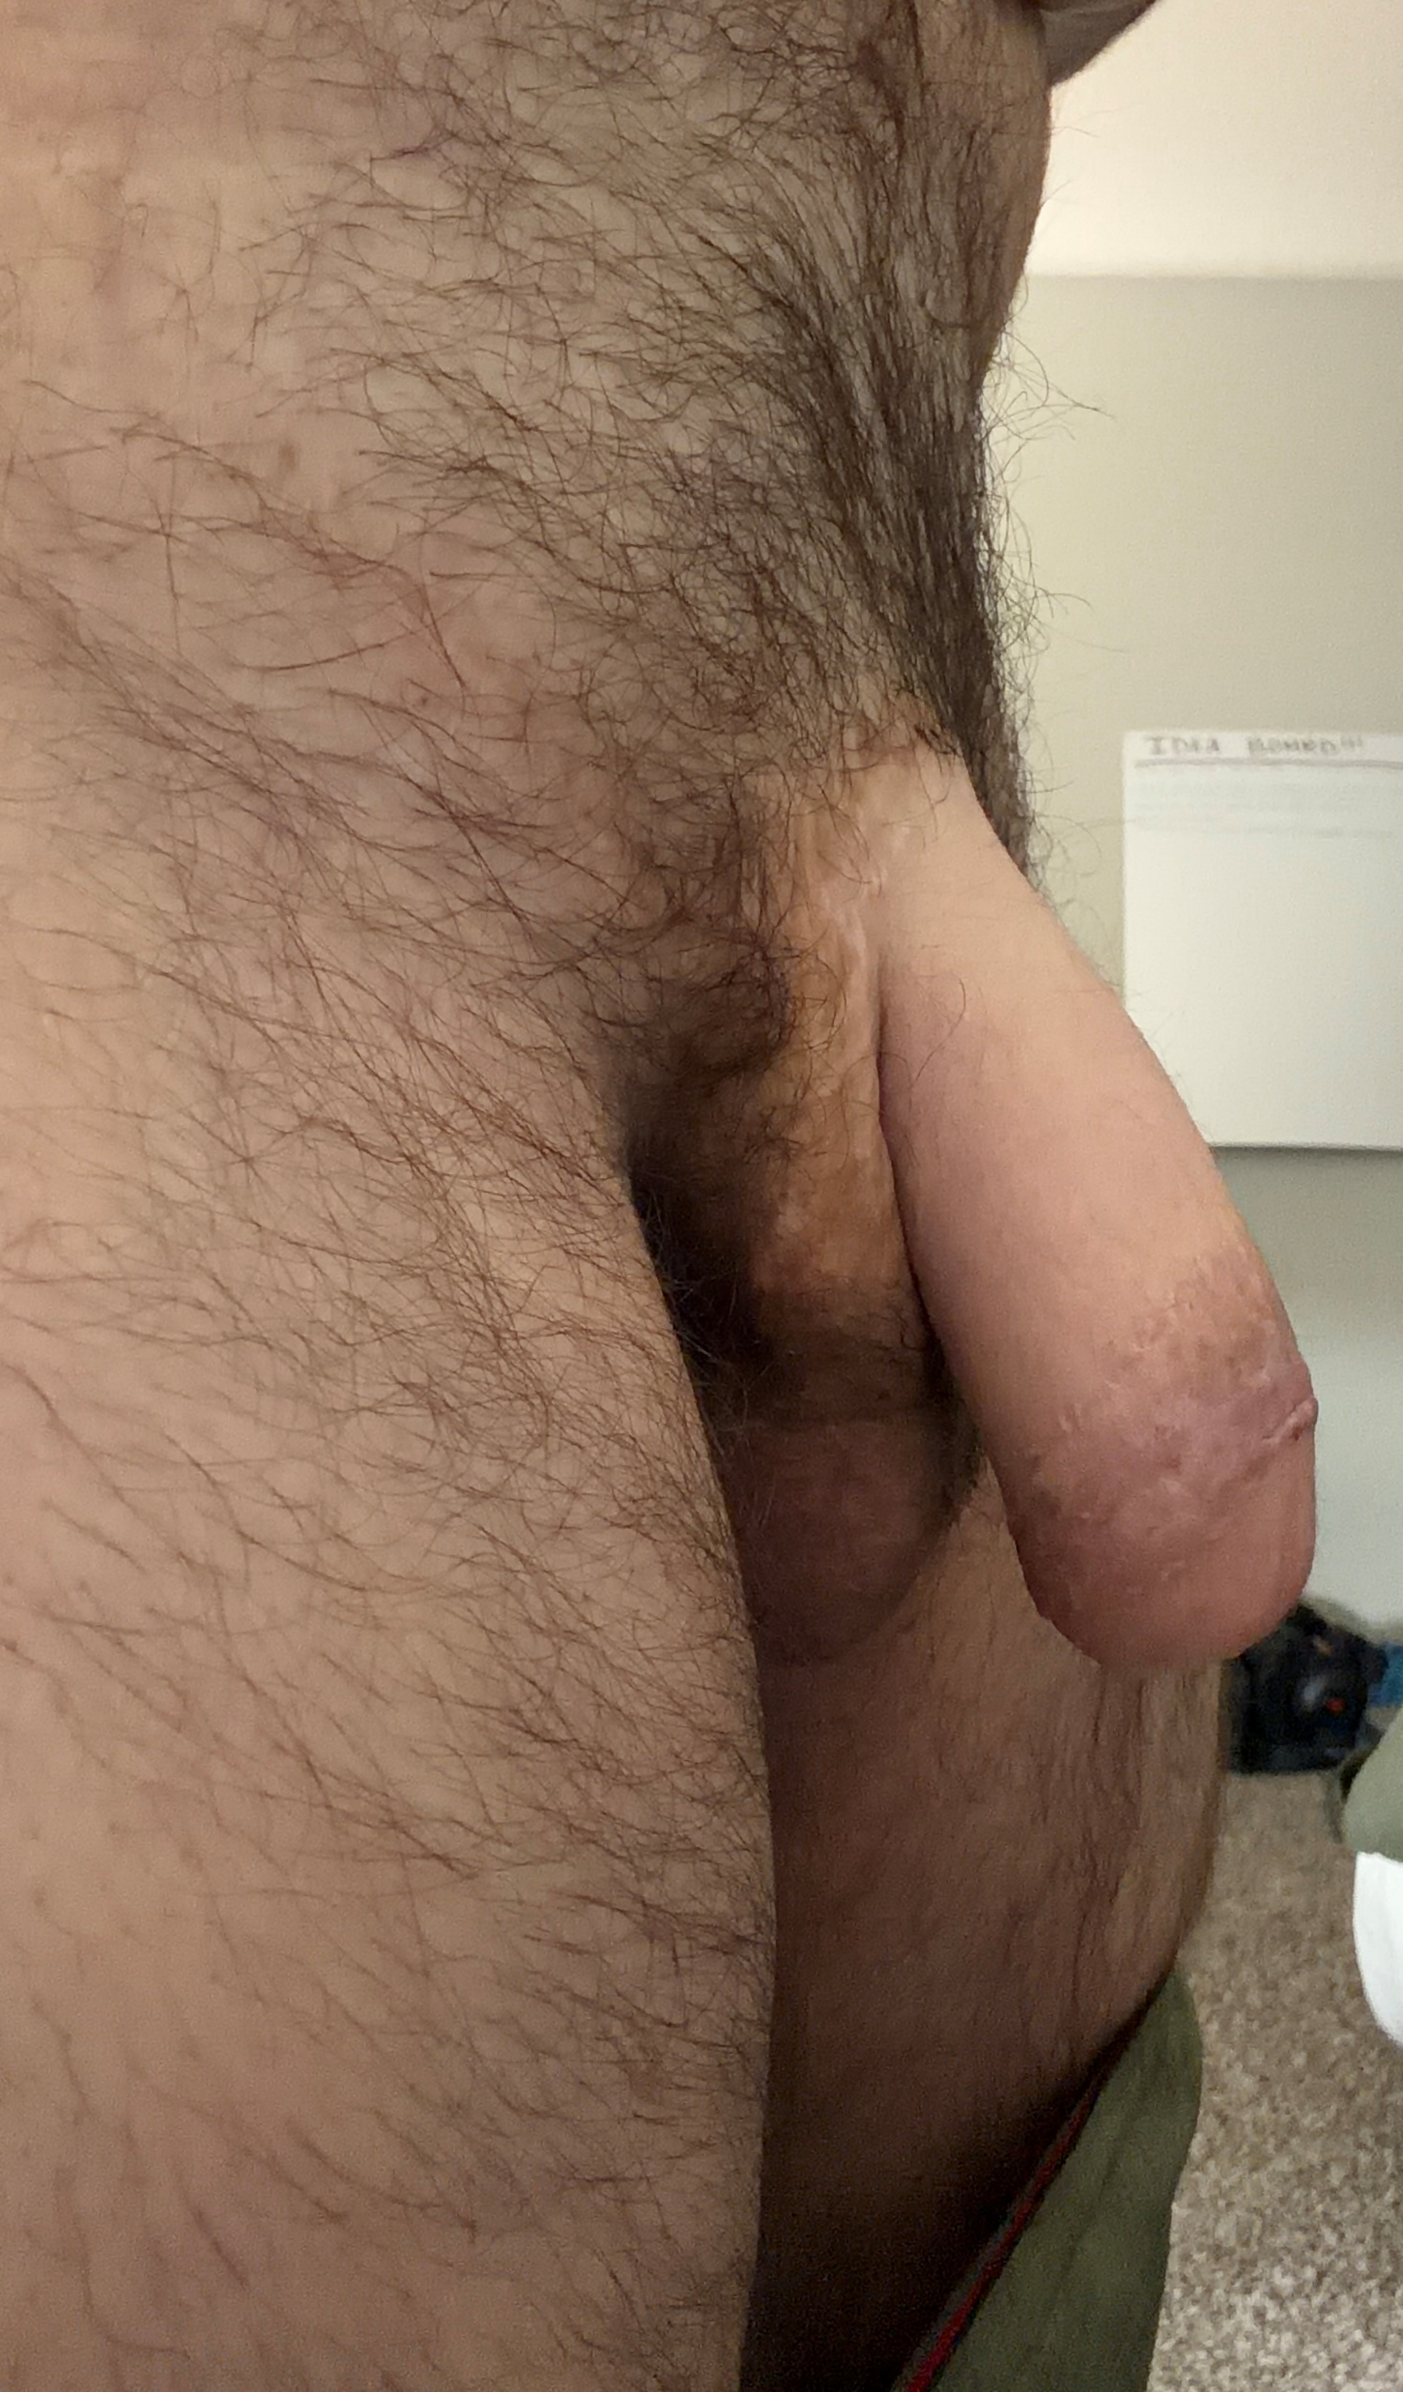
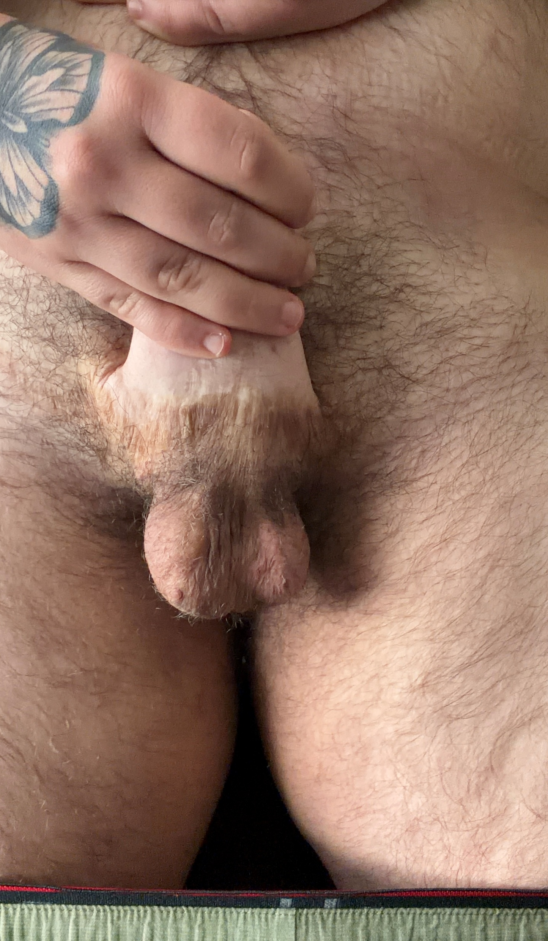

Slide 27
COSt
$485,359.00 vs
$5,800.00
PAID
Notes:
How much did the “extras” cost, such as time off work and travel?
Did not have to pay for hotel or Airbnb cost as my grandparents lived 45 minutes from the hospital
I used my short-term disability for income while in recovery

Slide 28
RFF Phalloplasty by Dr. Ashley Deleon at the Crane Center in Austin, TX
W: cranects.com
P: 512-446-9486
F: 512-597-0402
E: TXReception@CraneCTS.com
A: 4407 Bee Caves Rd Suit 612
Austin, TX 78746
H: Monday–Friday
8 am-4:30 pm CST
Locations: San Francisco, CA
Boulder, CO
Notes:
1. Who was your surgeon and why did you select that person? Dr. Deleon because she also did my top surgery and she's very particular in technique. Highly recommend
2. What do you wish you had known prior to the surgery? I had all of the information I needed going into the surgery through research and the crane center
3. What tips and advice can you give us? Be in a positive headspace leading up to surgery and in general. Understand that recovery is usually the hardest part, not the surgery itself. Do not get the surgery if there's any second guess thoughts in your head, mentally know that you want the surgery and its something that fits your transition. Do not get surgery just because others do, its not for everyone.
4. What are some online resources we should check out? Cranects.com as well as redditt r/phallo page (please don’t be one of those people that ask medical questions on these pages, ALWAYS contact your doctor)

