Slide 1
Gender Care at Legacy

Slide 2
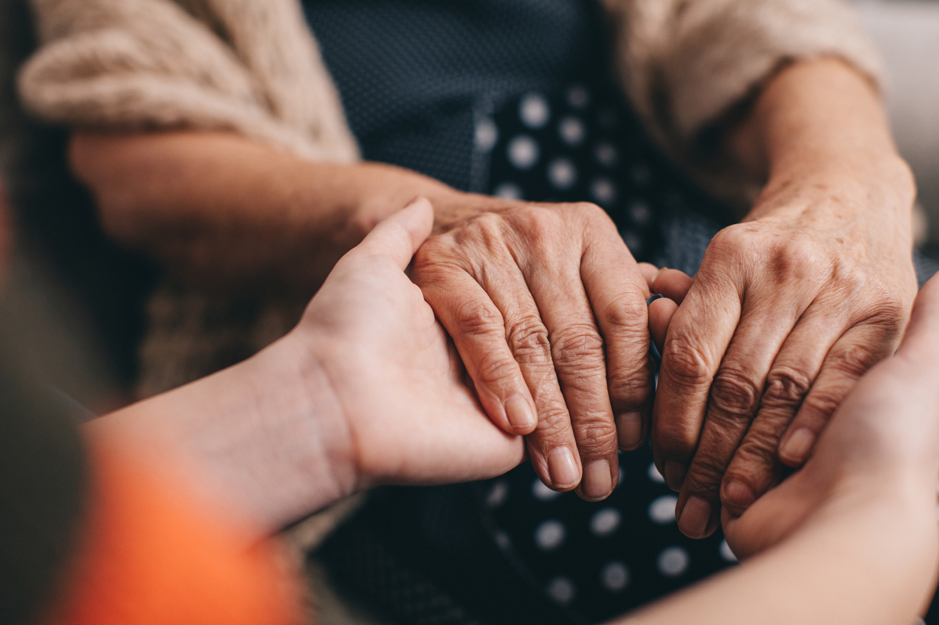
AGENDA
Introduction
How to Get Started
Financial Considerations
What to Expect at Your First Visit
Additional Services
Q & A

Slide 3
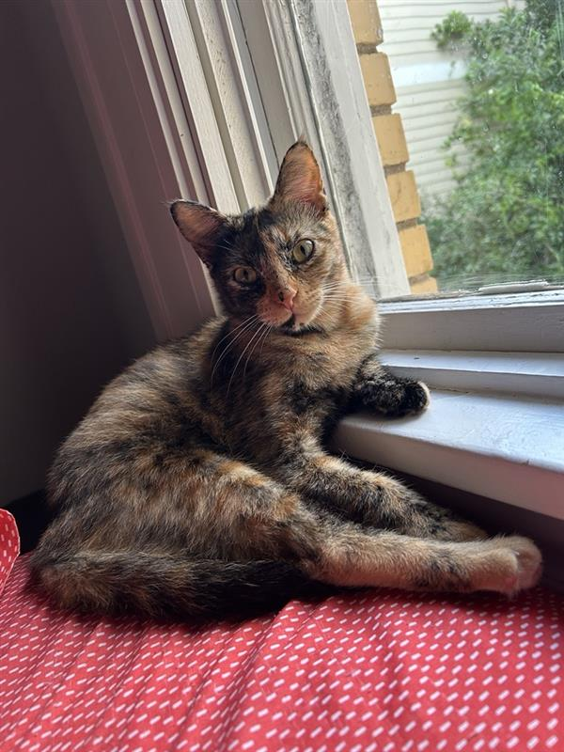
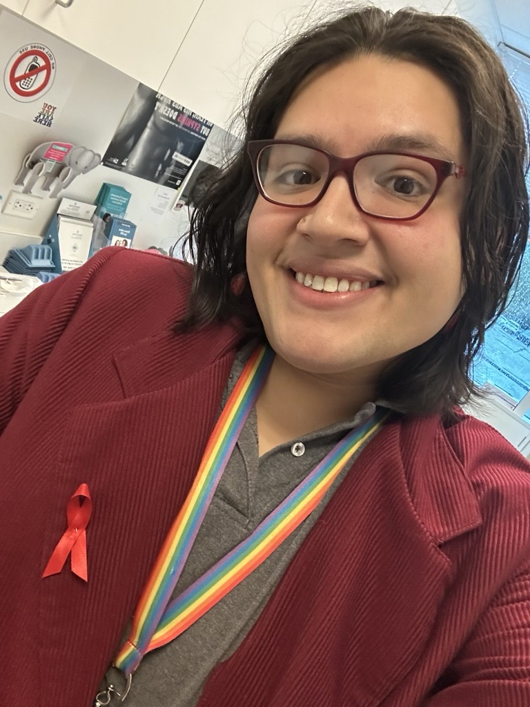
Introduction
Get to know Birdie
Grew up in Pasadena, TX.
Graduated with a degree in Government from UT Austin. Hook 'em!
Working in HIV Care & Services
since 2013.
Been with Legacy since 2022.
Currently serving as a Supervisor in Health Navigation.
Cat mom to Missy.
I play Magic: the Gathering!

Slide 4


How to Get Started?
Early Steps in Gender Care
Do some research.
Call our Health Navigation team to schedule appointments with a provider and/or Eligibility
(832-548-5221)
Come with questions and notes.

Slide 5

Financial Considerations
Being an FQHC, we provide services to anyone regardless of ability to pay.
Insurance
Self-pay
Eligibility
1) Applications for grants and programs patients might be able to use towards care
2) Sliding Scale

Slide 6

What to Expect at Your First Visit
At your first visit, the following topics may be discussed:
Sexual & reproductive health
Initial labs for hormone levels, STIs, etc.
Hormone Initiation
Additional Referrals

Slide 7

Additional Services
Pharmacy
Behavioral Health (Psychiatry, Therapy)
Gynecology
STI Testing
HIV & PrEP Care
Dental & Vision

Slide 8

Questions?

Slide 9
Contact Us
Birdie, 832-433-8416
brivera2@legacycommunityhealth.org
Health Navigation, 832-548-5221

Slide 10
Thank you!

